Slide 1
JSON (vs XML)
420-C50 S13

Slide 2
Objectives
JSON (refresher)
Why JSON is used
JSON vs. XML
JSON in JavaScript
JSON in jQuery
Notes:
Source

Slide 3
What is JSON?
JSON: JavaScript Object Notation.
JSON is syntax for storing and exchanging text information
JSON is lightweight text-data interchange format
JSON is language independent *
JSON is "self-describing" and easy to understand
* JSON uses JavaScript syntax for describing data objects, but parsers are available for many languages

Slide 4
Using JSON
Text format is syntactically identical to the code for creating JavaScript objects
Instead of using a parser, a JavaScript program can use the built-in eval() function and execute JSON data to produce native JavaScript objects

Slide 5
JSON Example
{ "employees": [ { "firstName":"John" , "lastName":"Doe" }, { "firstName":"Anna" , "lastName":"Smith" }, { "firstName":"Peter" , "lastName":"Jones" } ] }

Slide 6
Much Like XML
JSON is plain text
JSON is "self-describing" (human readable)
JSON is hierarchical (values within values)
JSON can be parsed by JavaScript
JSON data can be transported using AJAX

Slide 7
Unlike XML
No end tag
Shorter
Quicker to read and write
Can be parsed using built-in JavaScript eval()
Uses arrays
No reserved words
Notes:
Simpler, less complexity

Slide 8
JSON and XML
JSON can hold the same data, it’s just a different format
XML to JSON conversion
See samples: books.xml and books.JSON
You could write a converter yourself
XML to JSON converter
See: http://www.freeformatter.com/xml-to-json-converter.html
Notes:
Demonstrate by pulling in the XML from S08 (sales) and convert to JSON

Slide 9
Why JSON?
Easier and faster than XML
Using XML
Fetch an XML document
Use the XML DOM to loop through the document
Extract values and store in variables
Using JSON
Fetch a JSON string
eval() the JSON string

Slide 10
JSON Syntax
JSON syntax is a subset of the JavaScript object notation syntax.
Data is in name/value pairs
Data is separated by comma
Curly brackets holds objects
Square brackets holds arrays
{ "firstName":"John" , "lastName":"Doe" }
-- equivalent to --
firstName = “John”
lastName = “Doe;
Notes:
Compare books.xml and books.json

Slide 11
Squiggles, Squares, Colons & Commas
Squiggly brackets act as 'containers'
Square brackets holds arrays
Names and values are separated by a colon.
Array elements are separated by commas
Think ‘XML with Anorexia’
Notes:
Show example01
Anorexia?! Is that Politically Correct? ;-)

Slide 12
JSON Arrays
{ "employees": [ { "firstName":"John" , "lastName":"Doe" }, { "firstName":"Anna" , "lastName":"Smith" }, { "firstName":"Peter" , "lastName":"Jones" } ] }
employees[0].lastName; is the value “Doe”

Slide 13
JSON Files
The file type for JSON files is ".json"
The MIME type for JSON text is “application/json”
Can “GET” it in the same was as other gets, but must set the type as application/json

Slide 14
Converting JSON Object to Text
var txt = '{ "employees" : [' + '{ "firstName":"John" , "lastName":"Doe" },' + '{ "firstName":"Anna" , "lastName":"Smith" },' + '{ "firstName":"Peter" , "lastName":"Jones" } ]}';
JSON syntax is a subset of JavaScript syntax
Use JavaScript function eval() to convert a JSON text into a JavaScript object
eval() function uses the JavaScript compiler which will parse the JSON text and produce a JavaScript object
Text must be wrapped in parenthesis to avoid a syntax error
var obj = eval ("(" + txt + ")");
Notes:
Show example02
What is the problem with this? Security! SQL Injections in eval object of JavaScript

Slide 15
Security
The eval() function can compile and execute any JavaScript so this is a potential security problem
It is safer to use a JSON parser to convert a JSON text to a JavaScript object
A JSON parser will recognize only JSON text and will not compile scripts.
Native JSON support is included in newer browsers and in the newest ECMAScript (JavaScript) standard

Slide 16
parseJSON()
Can use parseJSON() to convert
Better than eval because it will not process JavaScript code
Syntax:
obj = $.parseJSON(txt);
Where obj is the name of the variable you are assigning the JSON to in JavaScript
Txt is the variable which is storing the JSON data

Slide 17
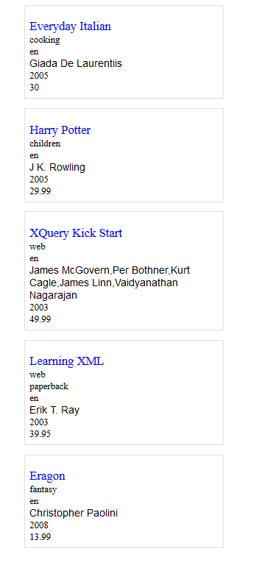
Exercise
Using the booksfixed.json file
Read in and display the books
Have a div for each book with a border
Each “key” type is a separate class so that you can style them separately (i.e. title, category, lang, author, year, price).
Each book fades in over 3 seconds

